Slide 1
Buying a home in Germany - Categorical geospatial study
Applied Data Science Capstone by IBM/Coursera

Slide 2
Buying a home in Germany - Categorical geospatial study in Bad Homburg vor der Höhe
Buying a home can be a good investment, especially if you are planning to take advantage of good market conditions. One of the most important and impactful decisions to make, when choosing to buy a home, is the location. The key factors of a great location are accessibility, appearance, and amenities available in a neighborhood.
Considering the amenities available in a neighborhood, these translate directly to a better living and quality of life, for example: consider not having to travel far to go to a doctor’s appointment, doing your shopping or dining or getting food in a good restaurant near your house, these are some of the hallmarks of a great neighborhood.
Our final objective is clustering and comparing areas to try to find and group the best places to live.

Slide 3

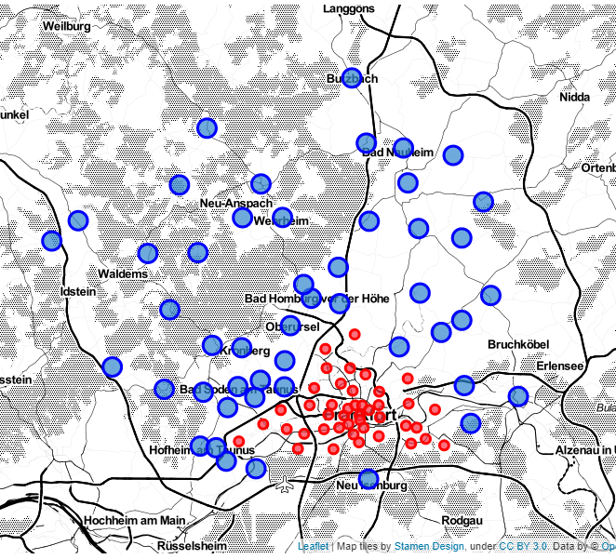
Locations to study
In the map we can see all areas involved in this study. Here you can see blue and red circles, these circles represent the individual areas where we will search for amenities. A blue circle area is 1000 meters, and the red circle area is 500 meters.
Why did we choose to make this distinction? Because comparing a small city to a big city it's not feasible, the difference in amenities density would be too big.
We will tolerate some overlapping because we want to find the places with the most amenities available and if it is within the radius of the area, we will keep it.

Slide 4
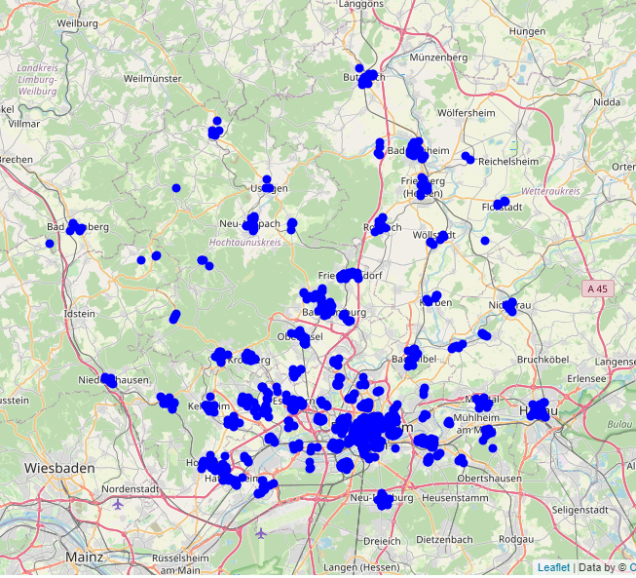
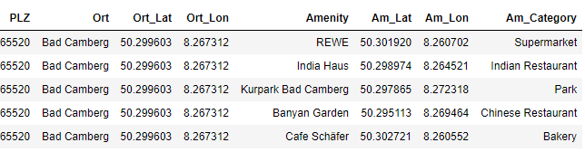
Amenities dataset

Slide 5
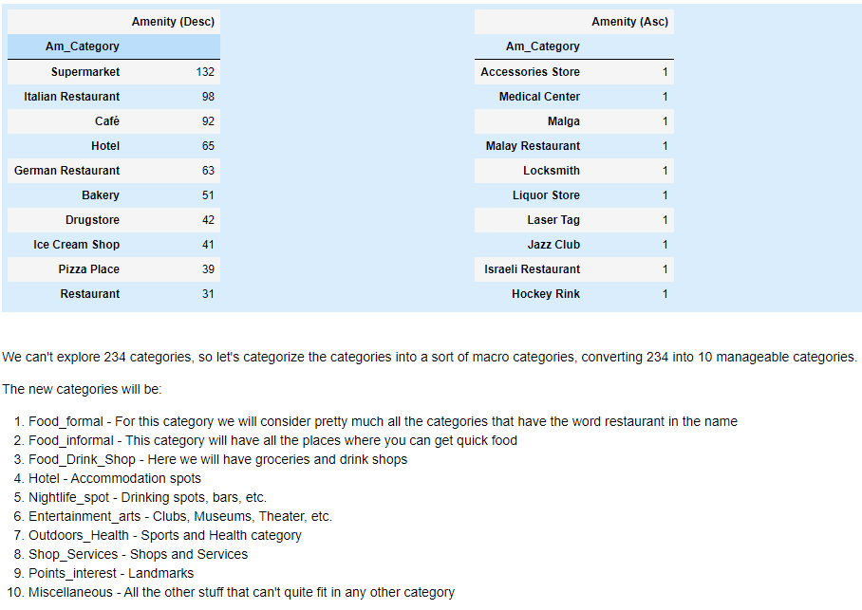
Amenities categories analysis

Slide 6
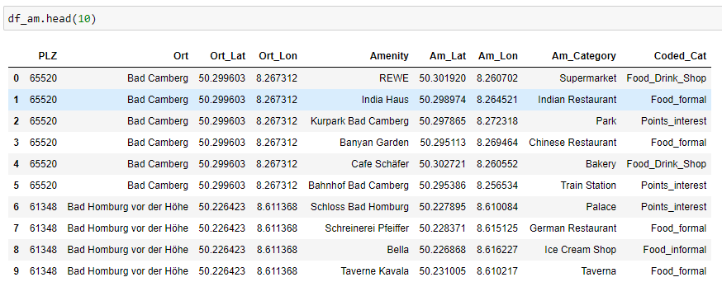
Recoded dataset

Slide 7
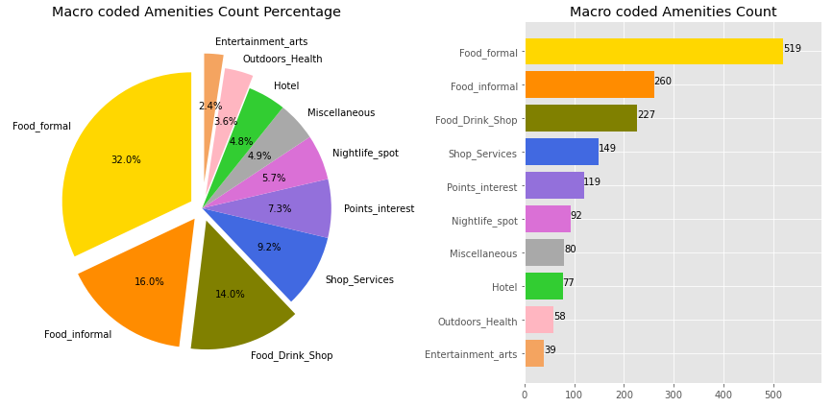
Amenities percentages and count
We have many Food related amenities.
We are poor in Entertainment and Arts amenities.
The food category (formal plus informal) makes up almost 50% of all amenities.
For fun the entertainment & arts, points of interest, outdoors & health and Nightlife Spots make up 19% of all amenities.

Slide 8
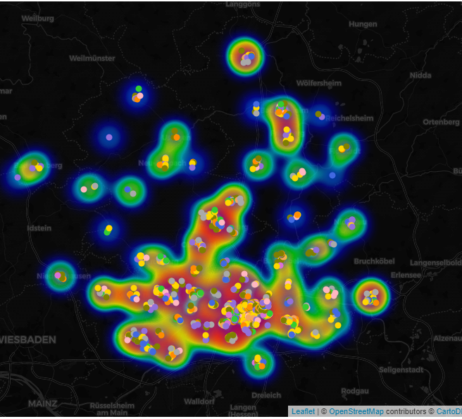
Mapping amenities with heatmap
In this map you see the amenities density. The redder the area the more amenities available. As we can see the areas previously identified appear in bright red.

Slide 9
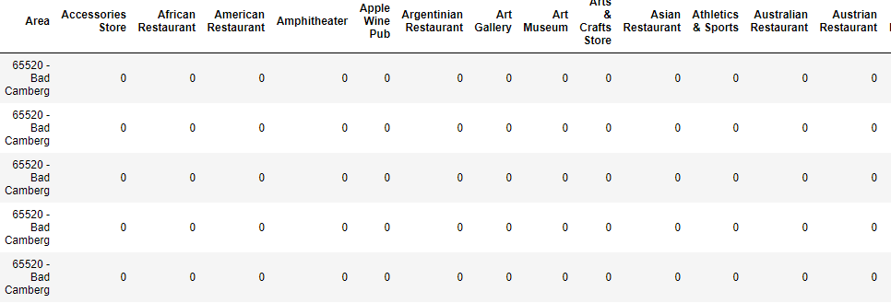
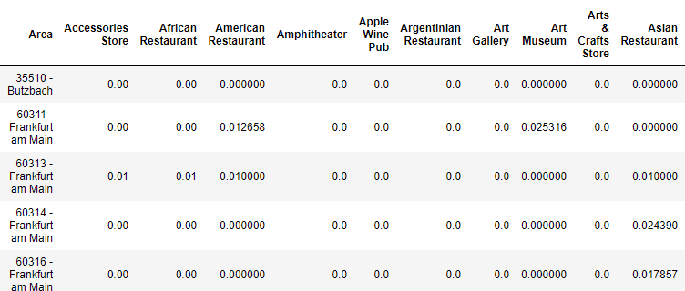
Preparing for K Means Clustering
Category onehot encoding
Row grouping by Area and by taking the mean of the frequency of occurrence of each category

Slide 10
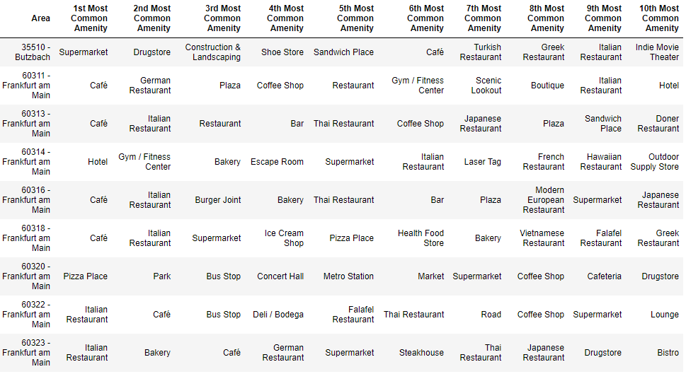
Most common amenities in each area

Slide 11
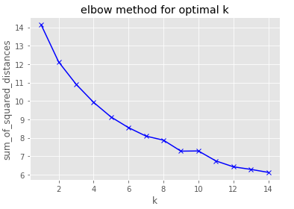
Evaluating optimal number of clusters - K
From the graph we are going to choose 7 as the optimal number of clusters for our analysis. We had some doubts whether to choose 7 or 8, but the subsequent metrics analysis proved better for 7.

Slide 12
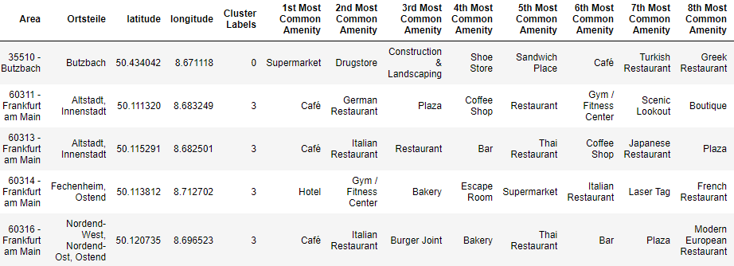
Areas – Cluster Labeled

Slide 13
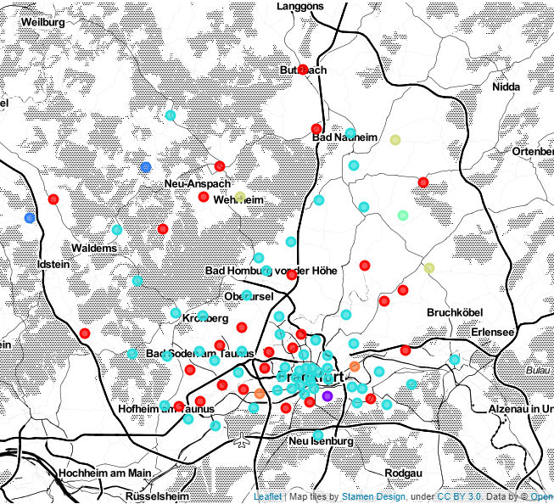
Cluster mapping
Cluster 0 - red
Cluster 1 - purple
Cluster 2 - blue
Cluster 3 - light blue
Cluster 4 - green
Cluster 5 - yellow
Cluster 6 - orange

Slide 14
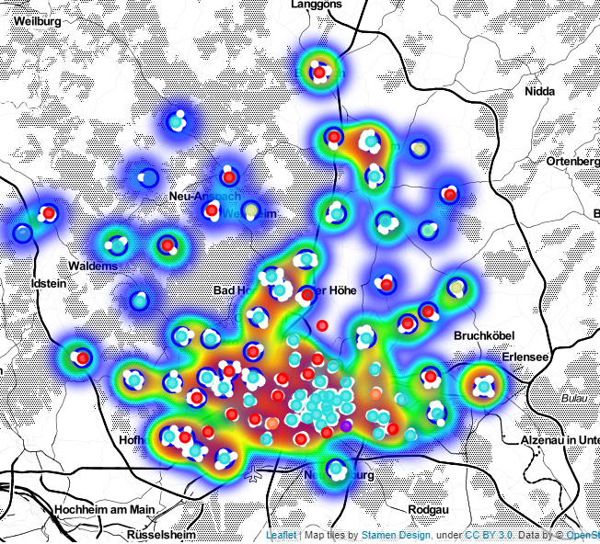
Putting it all together

Slide 15
Results
From our analysis we can see that the areas from cluster 0 and 3 have the most amenities while the remaining clusters only have between 1 and 3 areas with very few amenities.
Considering amenities density, cluster 0 areas, are near yellow zones and cluster 3 areas, are near red zones in the heatmap.
Ranking the clusters by number of amenities available we get:
Cluster 3 with the most amenities of all and greater variety category wise. Food related amenities account for the most common amenities in all areas.
Cluster 0 contains mostly shopping related amenities. Supermarket is the most common amenity in all clustered areas.
The remaining clusters 1,2,4,5 and 6 contain areas with low amenities density and little variety.
Cluster 3 contains 1436 amenities, while cluster 0 has 211 amenities and the remaining 26 belong to the combined clusters 1,2,4,5,6.

Slide 16
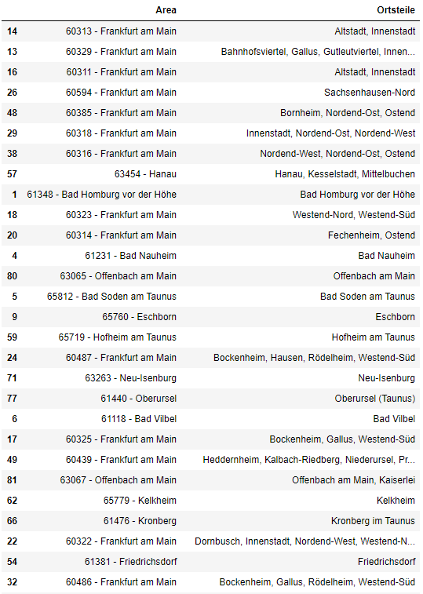
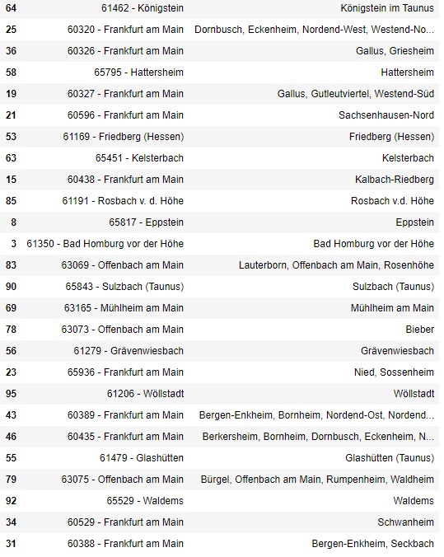
1 – Cluster 3 Areas

Slide 17
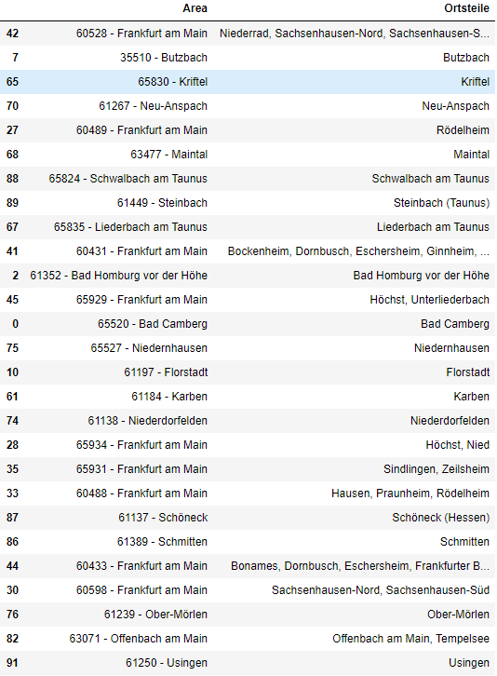
2 - Cluster 0 Areas

Slide 18
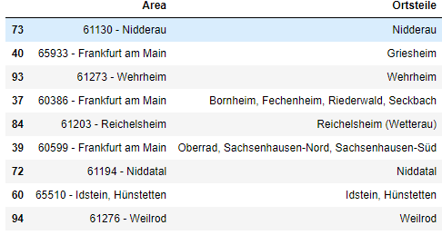
Clusters 1,2,4,5,6 Areas

Slide 19
Conclusions
This research aimed to provide information about areas to buy a house based on amenities availability. For that we used a machine learning algorithm - K means clustering - in a dataset comprised of the mean of the frequency of occurrence of each category in each area. As a result, we found the relevant clusters.
For us it is clear, based on our study, that pertaining to amenities density one should buy in one of the areas in cluster 3.
This, of course does not mean that you should be rushing to buy in any of those areas, further developing of this research is needed, this is only a starting point.
These results matter as a start for a larger study, and also there is room for improvement in this study. We should try to expand our amenities dataset, by pinpointing optimal coordinates or getting other sources. We should also include new datasets like housing market, quality of living indexes, etc. to explore other avenues of research. We should also try other machine learning clustering algorithms and compare results.

